Slide 1

Car Sales and Inventory Store Project

Slide 2
Team Members
1) Abhinay Kumar Yadav
2) Tanmay Agarwal
3) Tanay Singh
4) Himanshu Pandey
5) Harish Choudhary
6) Gaurav Chaturvedi

Slide 3
Abstract
The Waterfall Model was the first Process Model to be introduced. It is also referred to as a linear-sequential life cycle model. It is very simple to understand and use. In a waterfall model, each phase must be completed before the next phase can begin and there is no overlapping in the phases.
The Waterfall model is the earliest SDLC approach that was used for software development. The waterfall Model illustrates the software development process in a linear sequential flow. This means that any phase in the development process begins only if the previous phase is complete. In this waterfall model, the phases do not overlap.
Waterfall Model - Design
Waterfall approach was first SDLC Model to be used widely in Software Engineering to ensure
success of the project. In “The Waterfall” approach, the whole process of software development is divided into separate phases.
In this Waterfall model, typically, the outcome of one phase acts as the input for the next phase sequentially.

Slide 4
Problem Statement
This is an online car and car parts store that has listings of various cars along with their features. It also consists of car parts and accessories. This system allows user to buy car and inventory online. System allow user to check various car stats including car engine, mileage, tank capacity and other factors. Car booking has other methods for booking and registration and even a test drive registration. After registration user can login to the system with his username and password in order to access the system. User can check various car listing and can view each car features. User can also check features of the car as well as inventory parts. User may select the product and can add the product to shopping cart. User must register himself for the test drive. Car loan and other car booking facilities available in car buying section. This application is a combination of both sales and inventory management of the car and car parts. User can easily purchase car or car parts by using this system user does not have to come manually to shop to purchase the product. He can view the car and car parts in effective Graphical User Interface. User can view features of each product and can compare the products in order to purchase a better product.

Slide 5
Waterfall Model
We have selected this model because
The Waterfall Model was the first Process Model to be introduced. It is also referred to as a linear-sequential life cycle model. It is very simple to understand and use.
In a waterfall model, each phase must be completed before the next phase can begin and there is no overlapping in the phases.
The Waterfall model is the earliest SDLC approach that was used for software development.
The waterfall Model illustrates the software development process in a linear sequential flow.
This means that any phase in the development process begins only if the previous phase is
complete. In this waterfall model, the phases do not overlap.
Waterfall Model - Design
Waterfall approach was first SDLC Model to be used widely in Software Engineering to ensure success of the project.
In “The Waterfall” approach, the whole process of software development is divided into separate phases. In this Waterfall model, typically, the outcome of one phase acts as the input for the next phase sequentially.

Slide 6
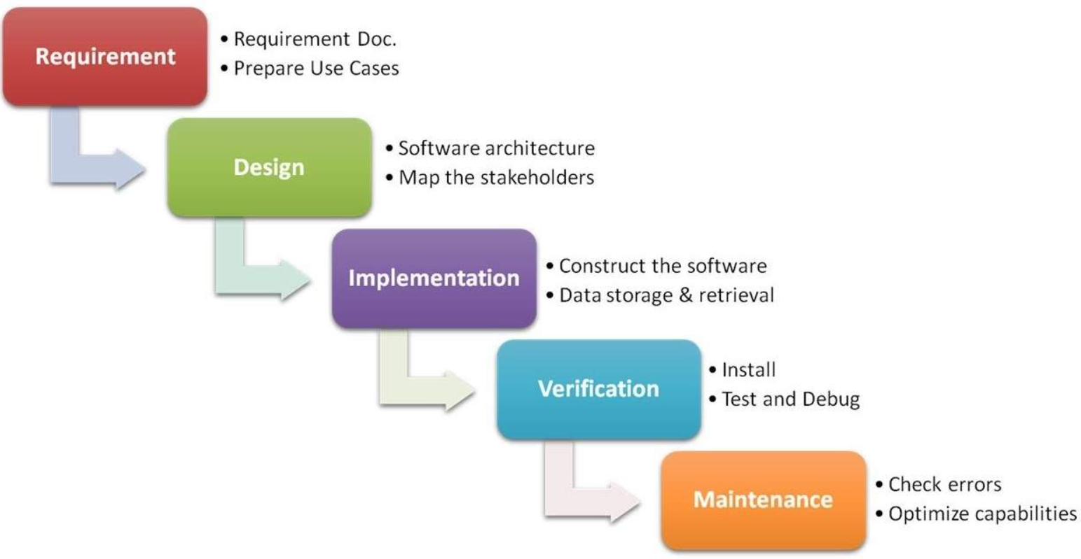
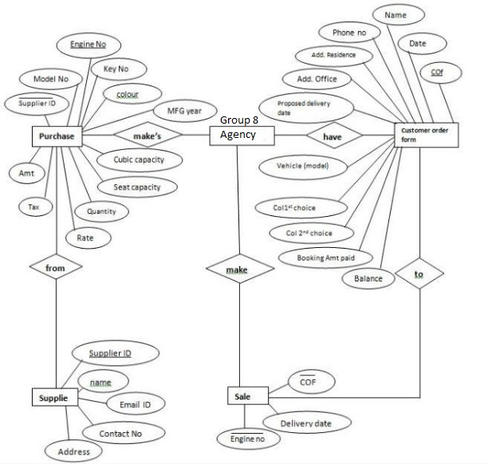
Pictorial Representation

Slide 7
Waterfall Model - Application
Every software developed is different and requires a suitable SDLC approach to be followed
based on the internal and external factors. Some situations where the use of Waterfall model is
most appropriate are −
Requirements are very well documented, clear and fixed.
Product definition is stable.
Technology is understood and is not dynamic.
There are no ambiguous requirements.
Ample resources with required expertise are available to support the product.

Slide 8
The project features:
Visitor Registration/ Login module.
User may check various car listing with features.
User may check the car features and inventory parts.
User may select and add products to shopping cart.
Credit card payment option for car parts shopping.
Test drive booking registration available.
Car loan and other car booking facilities available in car buying section.
d

Slide 9
Advantages
Some of the major advantages of the Waterfall Model are as follows −
Simple and easy to understand and use
Easy to manage due to the rigidity of the model. Each phase has specific deliverables and a review process.
Phases are processed and completed one at a time.
Works well for smaller projects where requirements are very well understood.
Clearly defined stages.
Well understood milestones.
Easy to arrange tasks.
Process and results are well documented.

Slide 10

THANK YOU

